Slide 1
2024-06-25_S12-S13-S14-S15
Sxx_Icell_txxxx_Cxxxx_J01
Gottfrid Olsson

Slide 2
Goals with this session
Investigate the same conditions for samples S07, S09 which had unusual deposition and/or bad washing (S14, S15)
Investigate same C0010 for different passivation (S12, S13)
Test data acquisition scheme (3x3 square matrix based on center point chosen manually)

Slide 3
I’ll use 10kV3.0nA

Slide 4
S12_Icell_t0012_C0010_J01

Slide 5
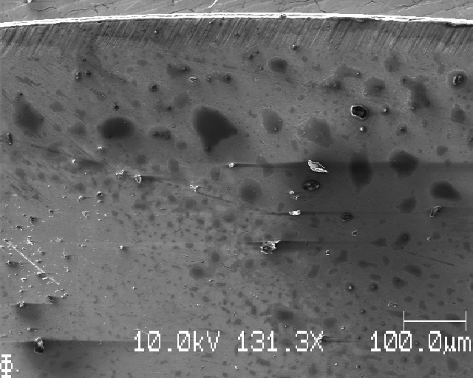
S12: top edge

Slide 6
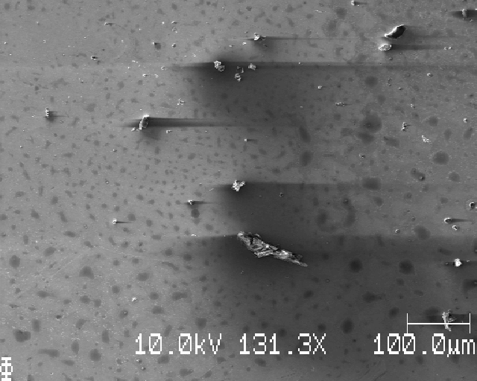
S12:moving down

Slide 7
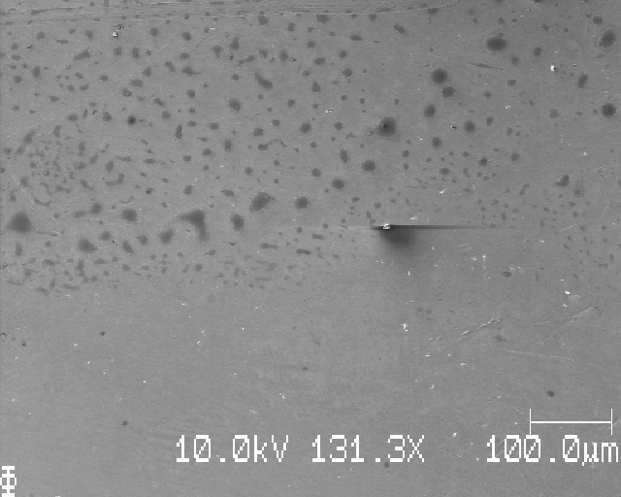
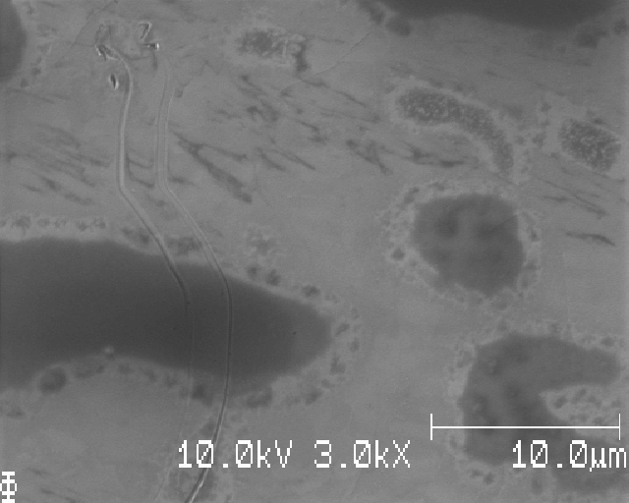
S12: looks like bad washing, but no bubbles

Slide 8
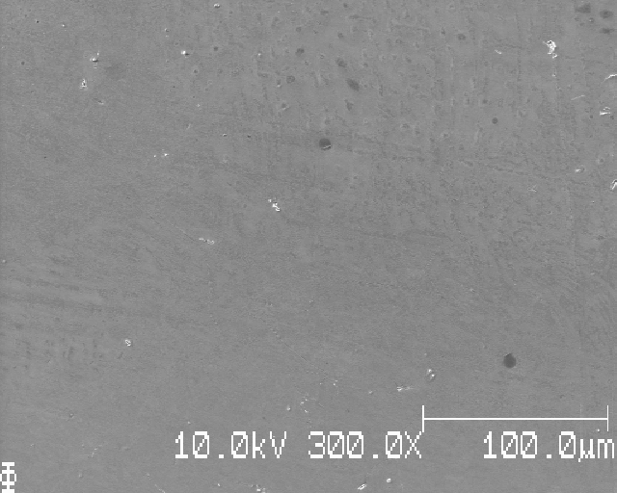
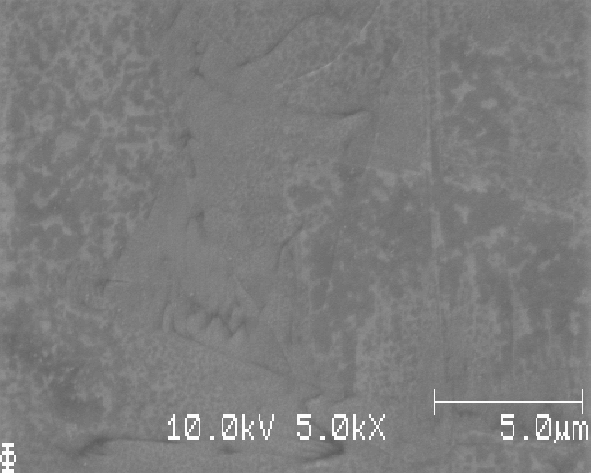
S12: down, looks cleaner here

Slide 9
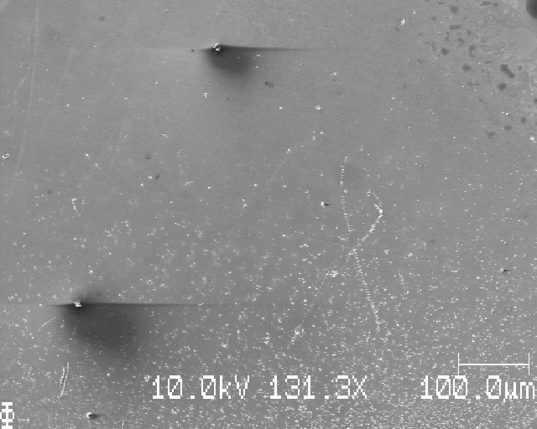
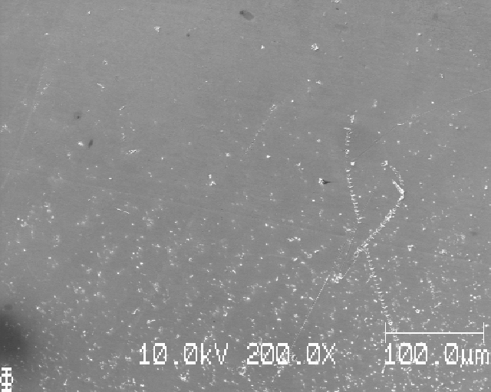
S12: top edge of deposition

Slide 10
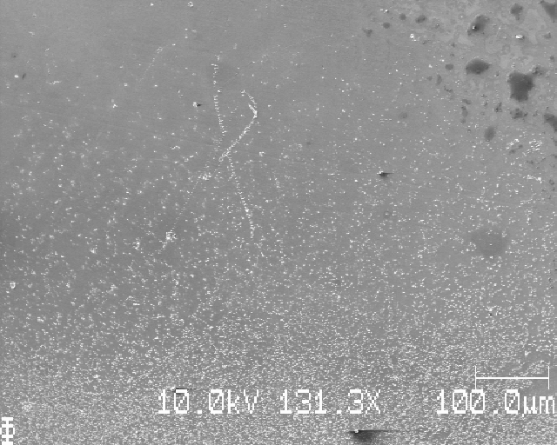
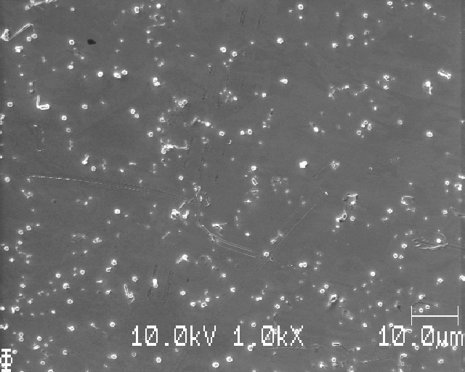
S12: top edge of deposition

Slide 11
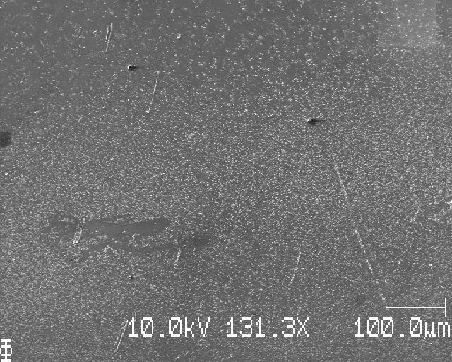
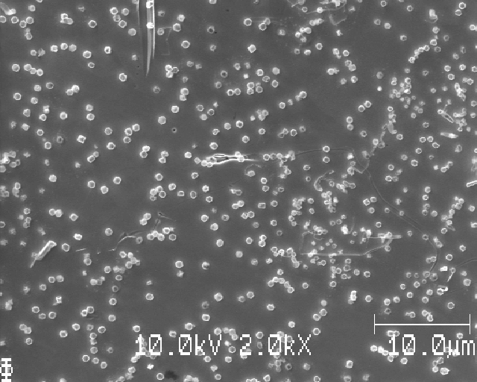
S12

Slide 12
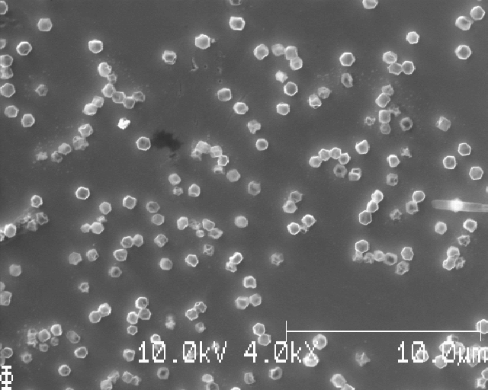
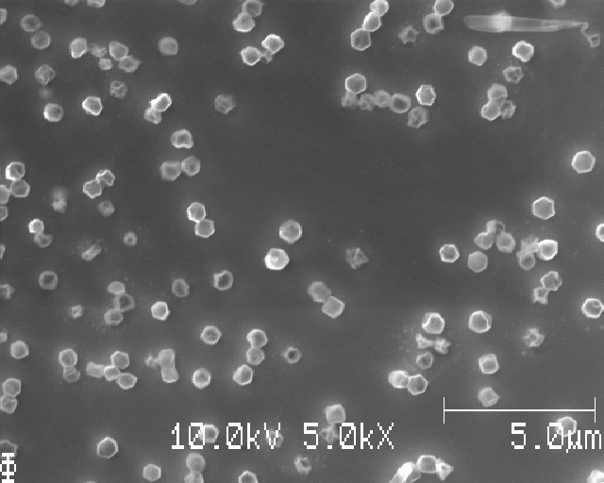
S12: choosing X5000 magnification for the images image analysis

Slide 13
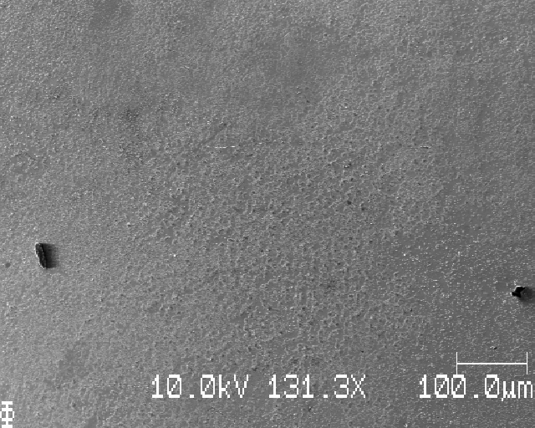
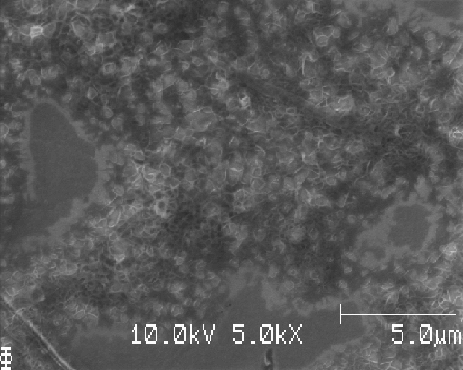
S12 further down; worms at this part

Slide 14
S12: matrix squares with dx=dy=500mu

Slide 15
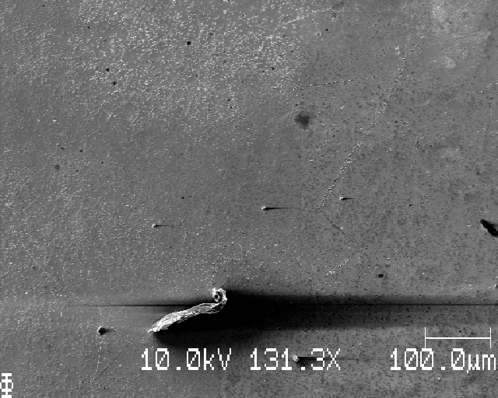
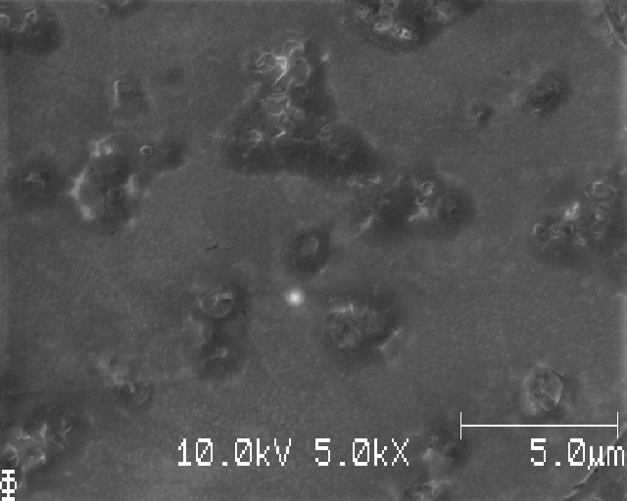
S12: M1

Slide 16
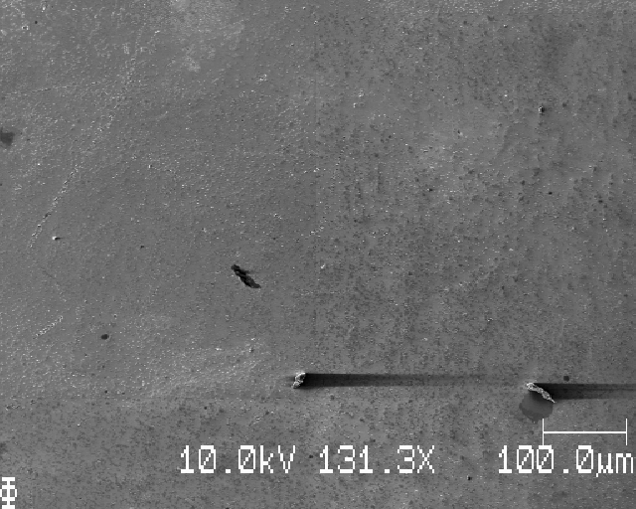
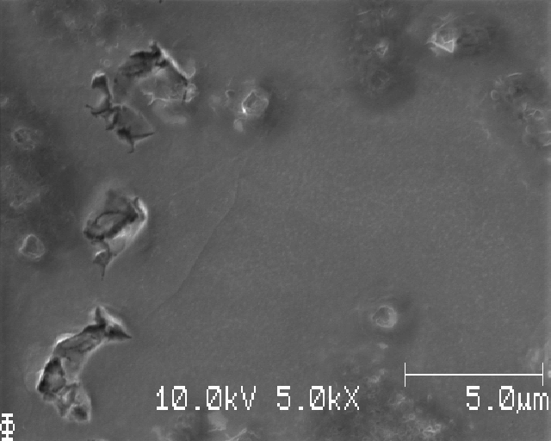
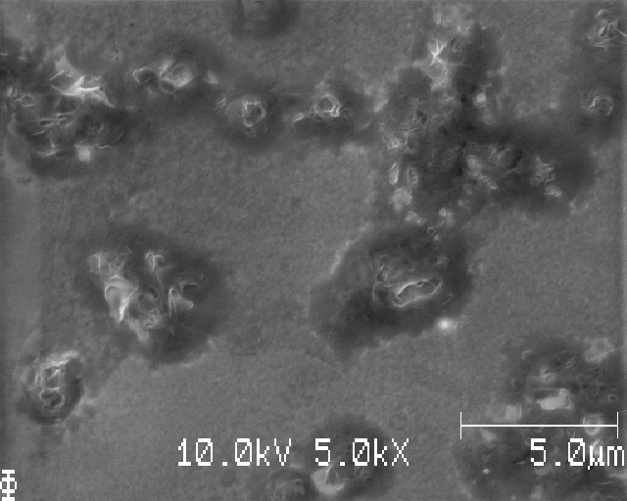
S12: M2

Slide 17
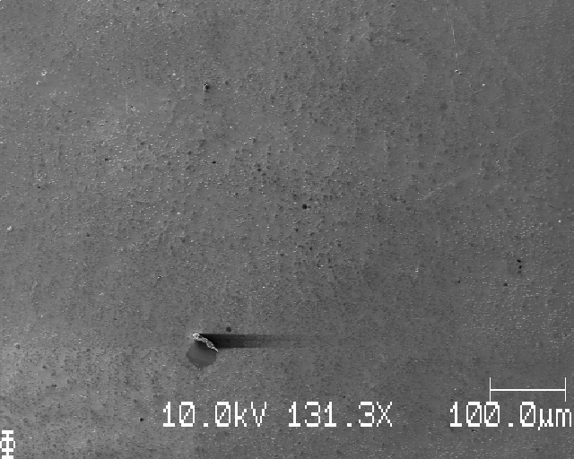
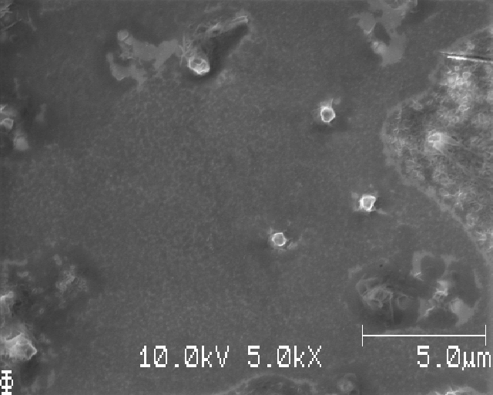
S12: M3

Slide 18
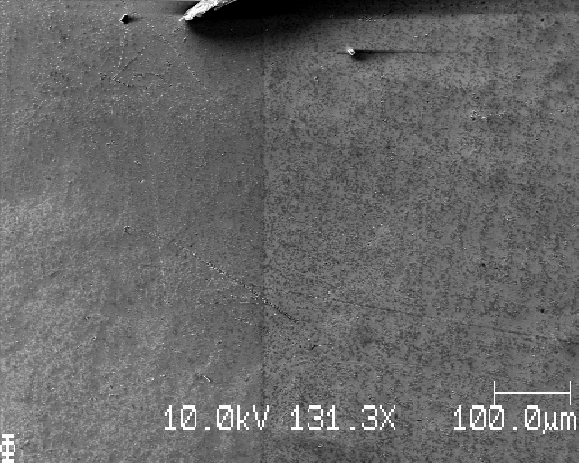
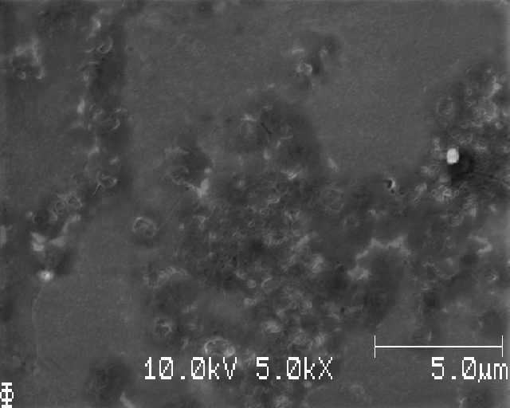
S12: M4

Slide 19
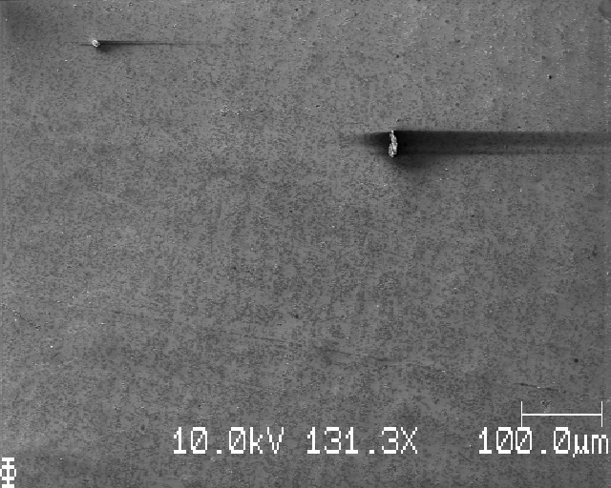
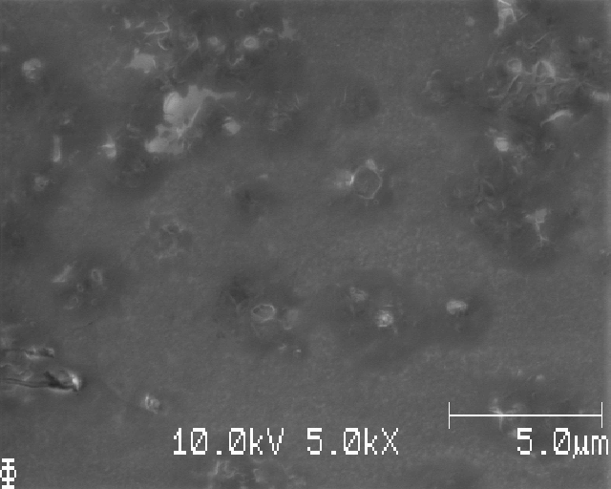
S12: M5 (matrix square 5 image of 9)

Slide 20
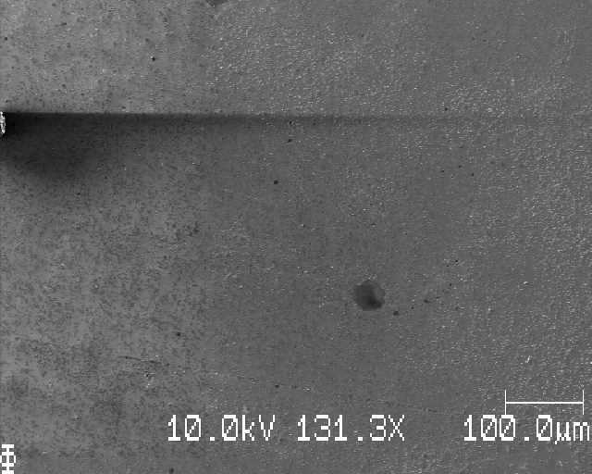
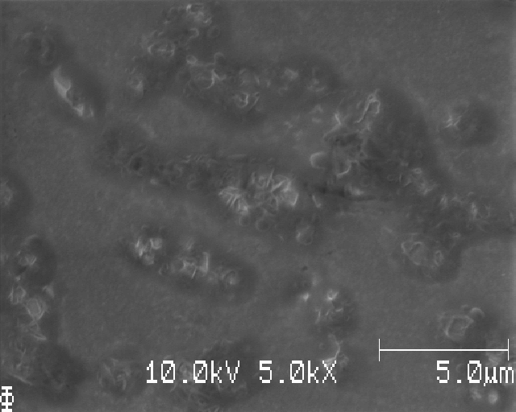
S12: M6

Slide 21
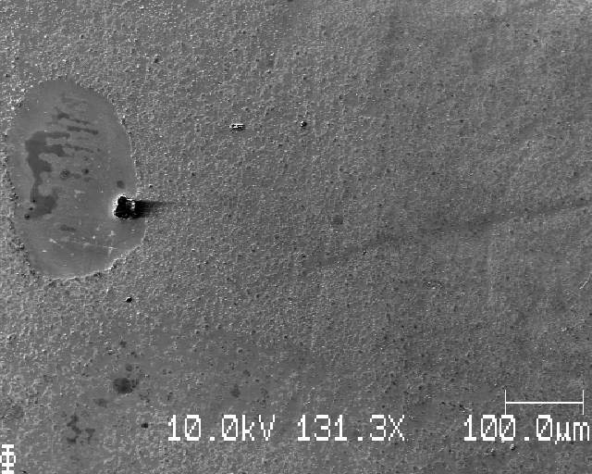
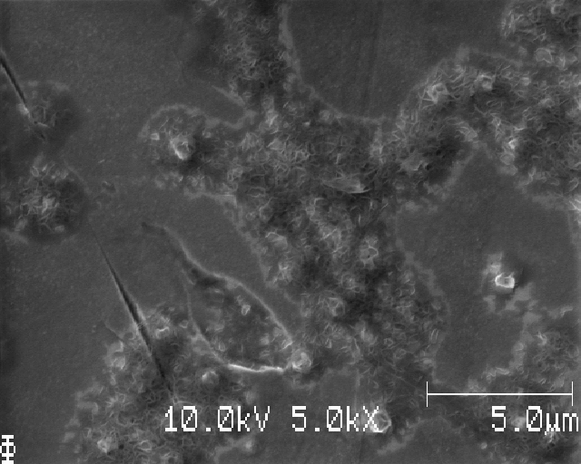
S12: M7

Slide 22
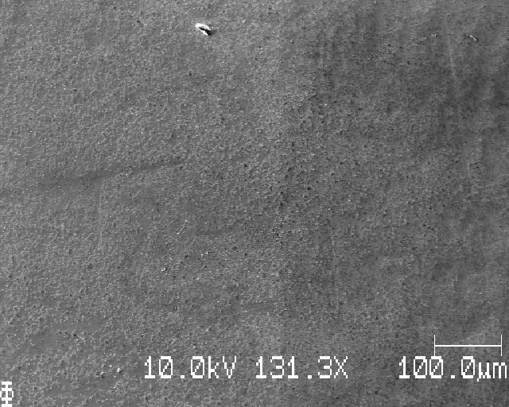
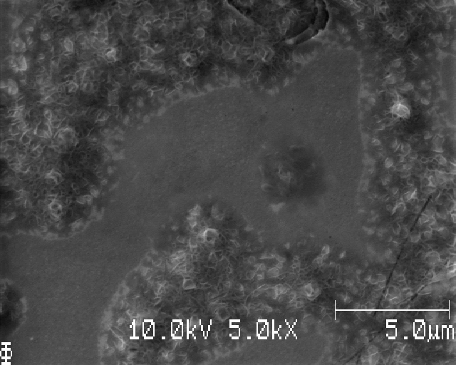
S12: M8

Slide 23
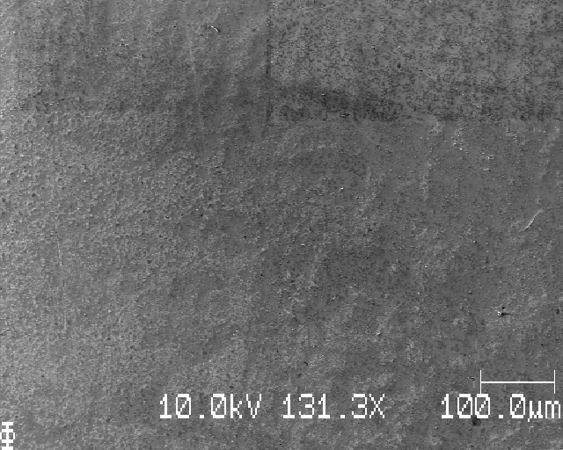
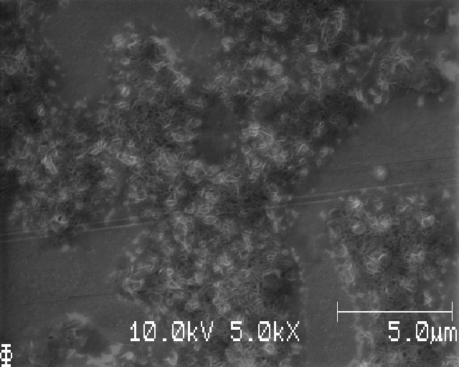
S12: M9

Slide 24
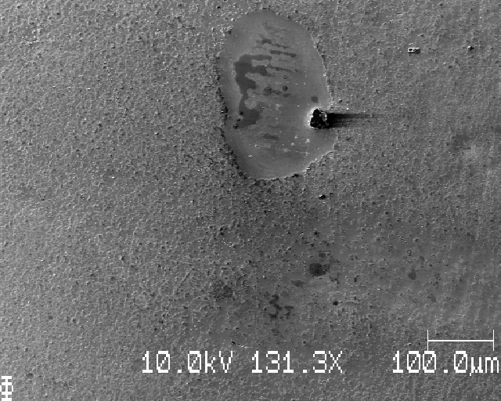
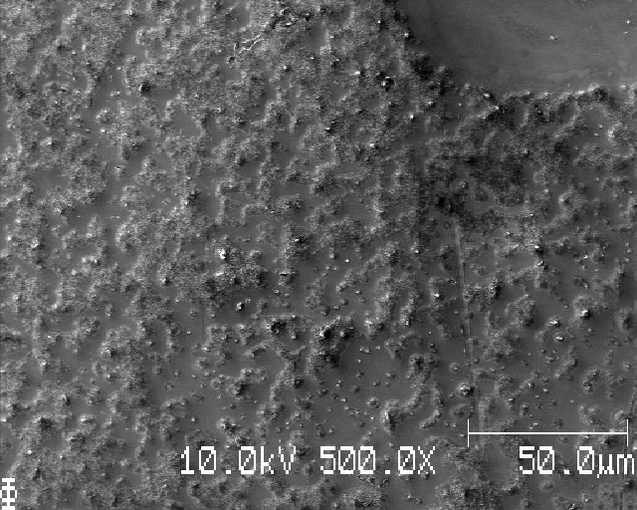
S12: different deposition in different areas

Slide 25
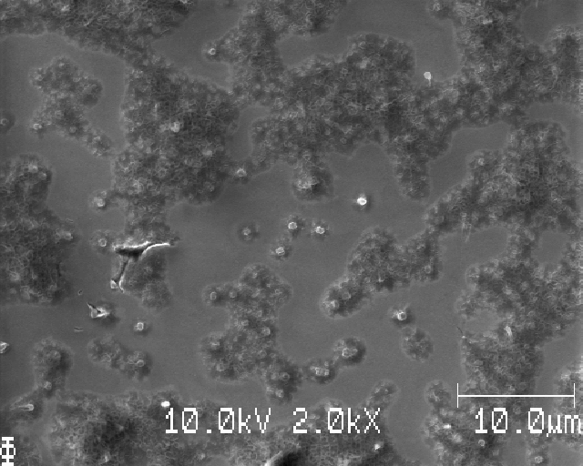
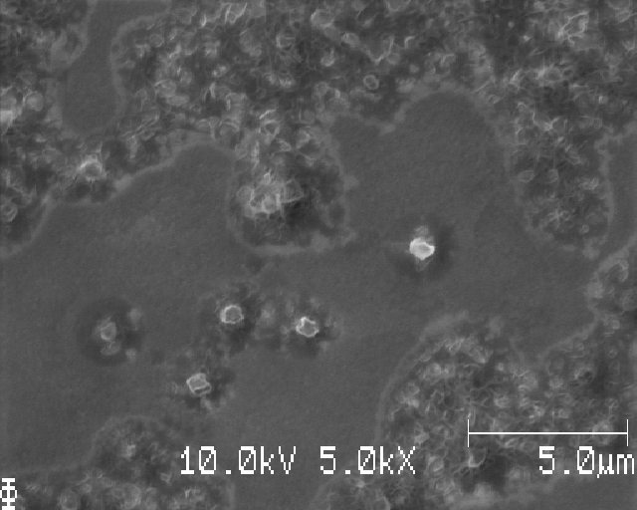
S12: same area; worm-like structures with barren areas in between

Slide 26
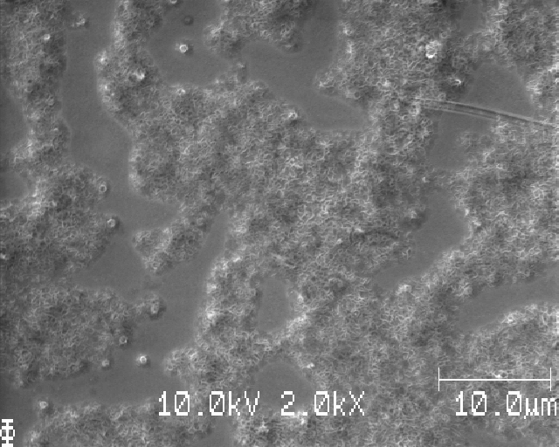
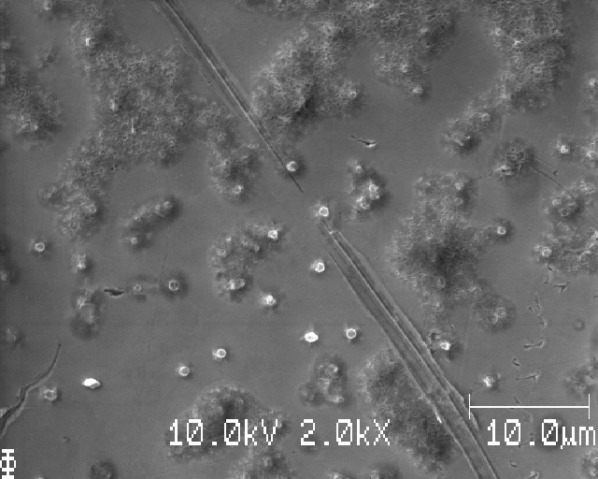
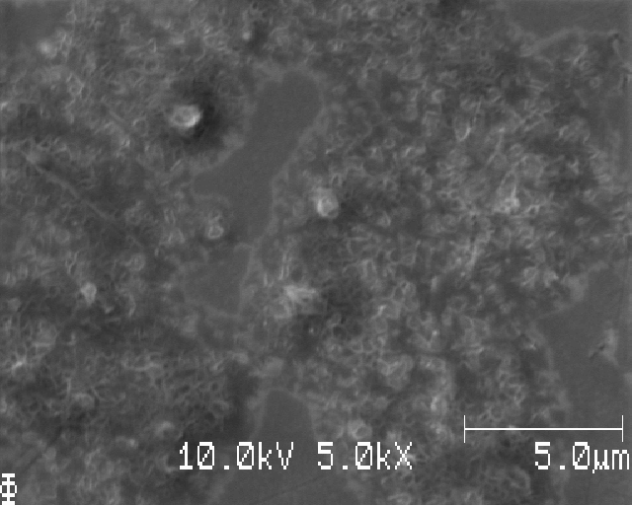
S12: same area; worm-like structures with barren areas in between && Li nuclei particles

Slide 27
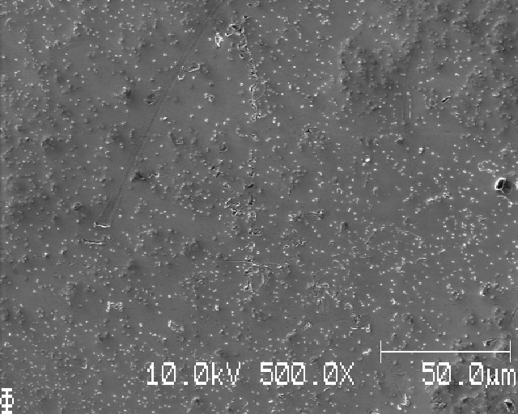
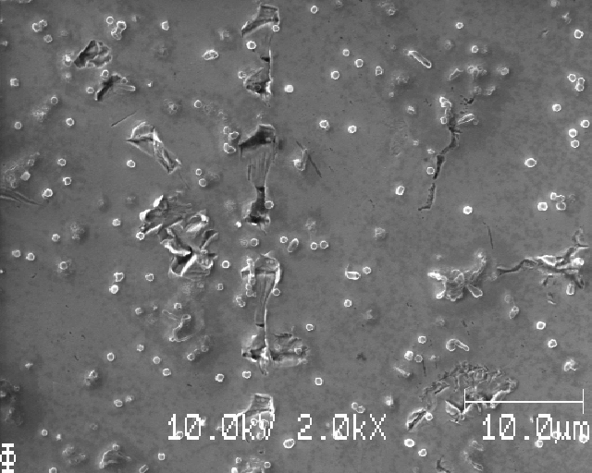
S12: another area further away; Li particles

Slide 28
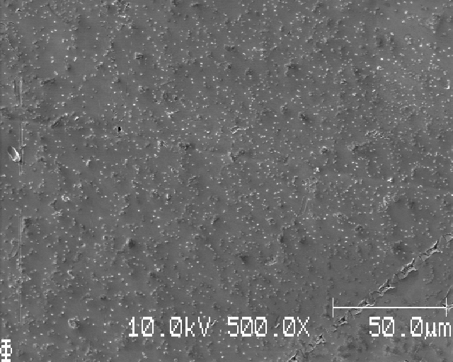
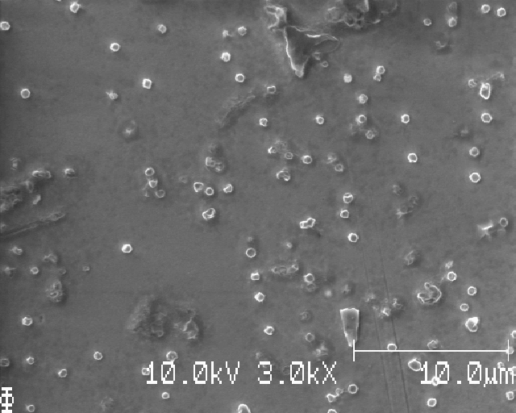
S12: another area, Li nuclei

Slide 29
S12: learning points
Li is unevenly deposited: clearly more in some places than others (locally too)
Saw areas with worm-like structures
with barren areas between areas of worm-like structures, but also Li nuclei mixed in
Saw areas with only Li nuclei

Slide 30
S13_Icell_t0060_C0010_J01

Slide 31
S13

Slide 32
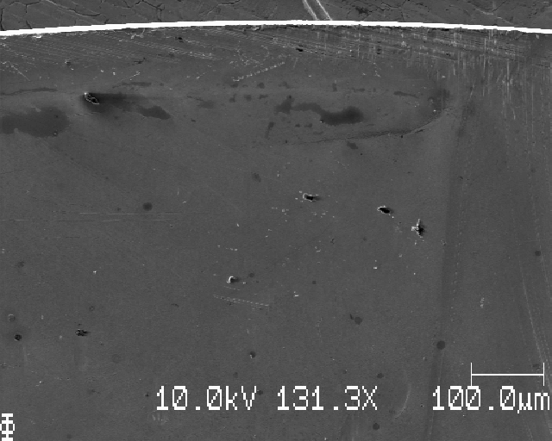
S13; edge of sample, moving downwards

Slide 33
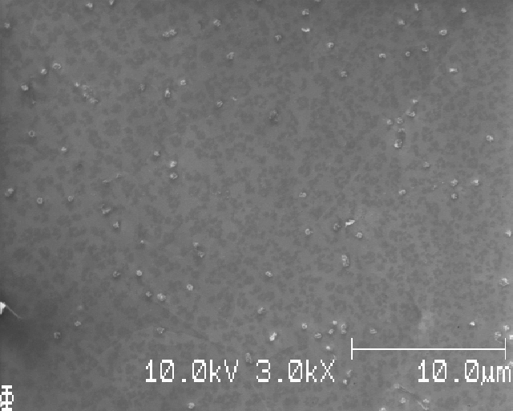
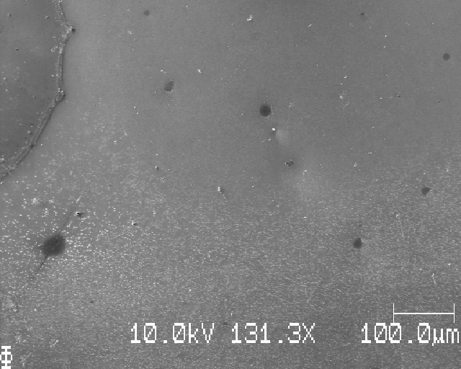
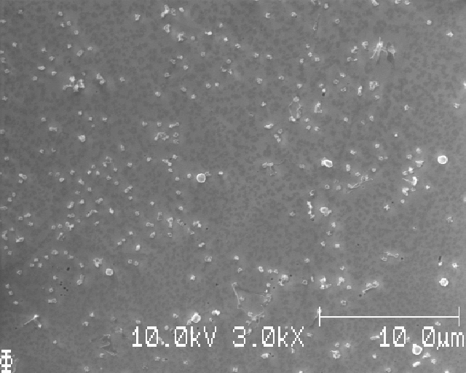
S13: edge of deposition

Slide 34


S13; just below the top edge of deposition

Slide 35


S13: further down (less deposition than in the edge of the deposition)

Slide 36


S13: further down, more Li again

Slide 37



S13: further down, big ‘hole’
Suuuper small Li?

Slide 38


S13;

Slide 39


S13; edge of ‘hole’

Slide 40



S13; below, particles of various size

Slide 41


S13; moving down – much more evenly deposited here compared to S12

Slide 42



S13; end of Li(?), why wavy and sudden edge? Also much smaller compare to last slide

Slide 43

S13; looks like smth was on the surface, edge of ring of that smth

Slide 44



S13; moving up along left EoD; super small Li

Slide 45


S13: zoom in on some black dirt?

Slide 46


S13

Slide 47


S13; the very small Li – corroded Li? They are much smaller and have weird shapes

Slide 48


S13; another place, dark Li?

Slide 49


S13; needle-like structures observed already at C0010

Slide 50
S13; matrix sampling dx=dy=1 mm

Slide 51



S13; M1

Slide 52



S13; M2

Slide 53



S13; M3

Slide 54



S13; M4

Slide 55



S13; M5

Slide 56



S13; M6

Slide 57



S13; M7

Slide 58



S13; M8

Slide 59



S13; M9

Slide 60
S13: learning points
Still a bit uneven Li deposition, but MUCH more even compared to S12
Should be good enough to do matrix-sampling and image analysis on
Various sizes of Li nuclei at the same time (position/SEM image)
Matrix-sampling seems to be a good idea
Easy and quite fast
Perhaps allow some finer manual adjustment of position (e.g. do not take in a ‘hole’ but rather the closest area to that ‘hole’ where there is Li instead)

Slide 61
S14_Icell_t1800_C0003_J01

Slide 62

S14: top edge

Slide 63

S14 : top EoD

Slide 64


S14; dark Li, some worm-like shapes also

Slide 65



S14; moving down, lots of no Li. Zooming in on one big bright thing – it moves when imaged

Slide 66


S14; bad wash again? :(

Slide 67


S14; another place

Slide 68



S14: following the deposition ring upwards

Slide 69
S14; many larger pieces of dirt on this sample

Slide 70



S14: left EoD, moving inwards →

Slide 71


S14;

Slide 72


S14; more right

Slide 73


S14;

Slide 74


S14; more right

Slide 75
S14; learning points
Looks like there is a ring-like deposition area (like in the coin cell)
more Li for large radii and less for smaller radii (measured from the center of the Li deposition)
No worm-like structures observed

Slide 76


S15; a lot of shite (bad wash >:( …)

Slide 77



S15: close to edge (right); stripey

Slide 78


S15; following the ‘valley’ towards the middle

Slide 79

S15; looking at the dirt/shite (further down)

Slide 80


S15; mostly bad washing, some parts have clear Li particles, e.g.

Slide 81
S15: learning points
Bad wash (a LOT of large dark areas that bubbled when imaged)
Uneven wash: totally good in a few places, very bad in most places

